Slide 1
Build React SPAs with the Microsoft Graph

Slide 2

Register Azure AD Applications
Microsoft Application Registration Portal
Configure credentials
Select the type of application
Configure permissions

Slide 3
Azure AD Portal
Azure AD Portal
https://portal.azure.com
Login using Microsoft Account (MSA) / Azure AD account (work or school)
Create Azure AD apps that use the v1 and v2 authorization endpoint
Use Azure AD’s ADAL or MSAL SDK for authentication

Slide 4
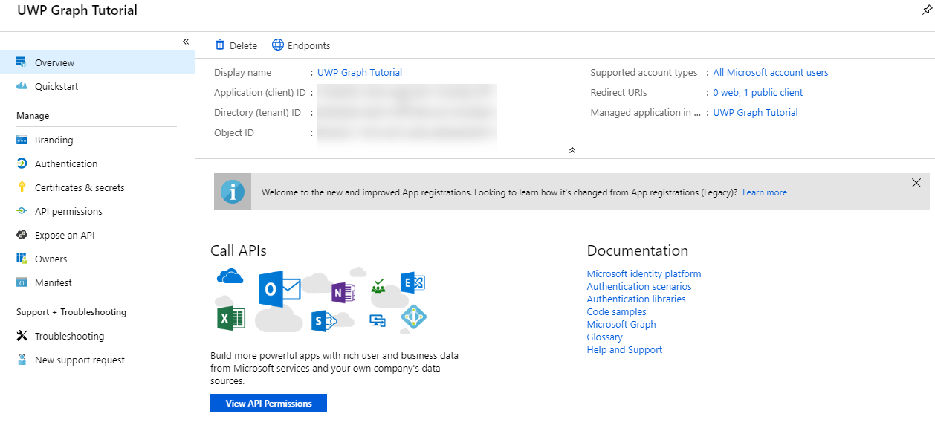
App Registration
Create the application
Copy the application’s ID
Add redirect uri to the app
Notes:
For Microsoft Graph apps, it’s recommended to use the Azure AD v2 authorization endpoint
Create the application
Copy the Application ID
Add a new Native application and add the necessary permissions

Slide 5
Demo

Slide 6
Thank you.

